Slide 1
TRUTH TABLES WITH UNDEFINED AND FLOATING INPUTS
SystemVerilog sometimes can determine the output of logic operation despite some inputs being unknown.
& |  | A
 |  | 0 | 1 | z | x
B | 0 | 0 | 0 | 0 | 0
 | 1 | 0 | 1 | x | x
 | z | 0 | x | x | x
 | x | 0 | x | x | x
| |  | A
 |  | 0 | 1 | z | x
B | 0 | 0 | 1 | x | x
 | 1 | 1 | 1 | 1 | 1
 | z | x | 1 | x | x
 | x | x | 1 | x | x

Slide 2
Free tools
Simulatore (icarus verilog):
sudo apt-get iverilog
Sintesi (yosys):
sudo apt-get yosys
Visualizzatore schematici
sudo npm install -g netlistsvg
Visualizzatore waveforms
sudo apt-get gtkwave
Vivado FPGA design suite
https://www.xilinx.com/support/download.html

Slide 3
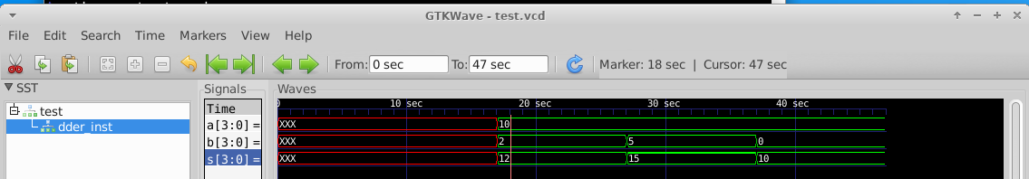
Esempio sommatore: simulazione
$ iverilog -g2005-sv -o testbench adder_tb.sv adder.sv
$ ./testbench
$ gtkwave test.vcd

Slide 4
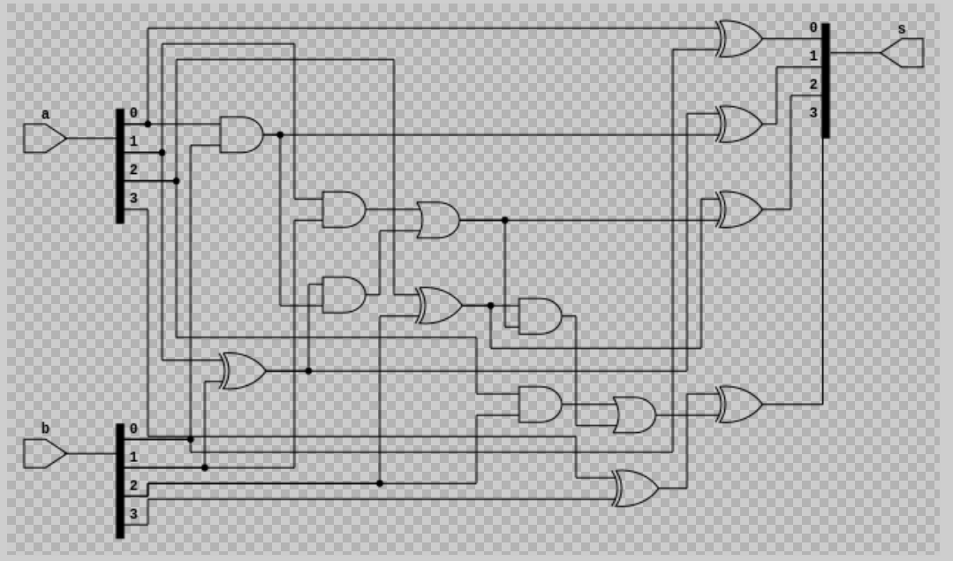
Esempio sommatore: sintesi
$ yosys synth_adder.ys
$ netlistsvg adder.js -o adder.svg
$ ristretto adder.svg

Slide 5
Delays
module example(input logic a, b, c,
output logic y);
logic ab, bb, cb, n1, n2, n3;
assign #1 {ab, bb, cb} = ~{a, b, c};
assign #2 n1 = ab & bb & cb;
assign #2 n2 = a & bb & cb;
assign #2 n3 = a & bb & c;
assign #4 y = n1 | n2 | n3;
endmodule
y = ~a & ~b & ~c | a & ~b & ~c | a & ~b & c;

Slide 6
Delays
module example(input logic a, b, c,
output logic y);
logic ab, bb, cb, n1, n2, n3;
assign #1 {ab, bb, cb} =
~{a, b, c};
assign #2 n1 = ab & bb & cb;
assign #2 n2 = a & bb & cb;
assign #2 n3 = a & bb & c;
assign #4 y = n1 | n2 | n3;
endmodule

Slide 7
Delays
1
module example(input logic a, b, c,
output logic y);
logic ab, bb, cb, n1, n2, n3;
assign #1 {ab, bb, cb} =
~{a, b, c};
assign #2 n1 = ab & bb & cb;
assign #2 n2 = a & bb & cb;
assign #2 n3 = a & bb & c;
assign #4 y = n1 | n2 | n3;
endmodule

Slide 8
Delays
2
module example(input logic a, b, c,
output logic y);
logic ab, bb, cb, n1, n2, n3;
assign #1 {ab, bb, cb} =
~{a, b, c};
assign #2 n1 = ab & bb & cb;
assign #2 n2 = a & bb & cb;
assign #2 n3 = a & bb & c;
assign #4 y = n1 | n2 | n3;
endmodule

Slide 9
Delays
module example(input logic a, b, c,
output logic y);
logic ab, bb, cb, n1, n2, n3;
assign #1 {ab, bb, cb} =
~{a, b, c};
assign #2 n1 = ab & bb & cb;
assign #2 n2 = a & bb & cb;
assign #2 n3 = a & bb & c;
assign #4 y = n1 | n2 | n3;
endmodule
2

Slide 10
Delays
module example(input logic a, b, c,
output logic y);
logic ab, bb, cb, n1, n2, n3;
assign #1 {ab, bb, cb} =
~{a, b, c};
assign #2 n1 = ab & bb & cb;
assign #2 n2 = a & bb & cb;
assign #2 n3 = a & bb & c;
assign #4 y = n1 | n2 | n3;
endmodule
4

Slide 11
Always Statement
General Structure:
always @(sensitivity list)
statement;
Whenever the event in sensitivity list occurs, statement is executed

Slide 12
Other Behavioral Statements
Statements that must be inside always statements:
if / else
case, casez
for

Slide 13
Combinational Logic using always
// combinational logic using an always statement
module gates(input logic [3:0] a, b,
output logic [3:0] y1, y2, y3, y4, y5);
always_comb // need begin/end because there is
begin // more than one statement in always
y1 = a & b; // AND
y2 = a | b; // OR
y3 = a ^ b; // XOR
y4 = ~(a & b); // NAND
y5 = ~(a | b); // NOR
end
endmodule
This hardware could be described with assign statements using fewer lines of code, so it’s better to use assign statements in this case.

Slide 14
General Rules for Combinational Logic
If generic always is used, sensitivity list MUST include all signals used in the always.
all outputs should have default values or must be assigned for every input combination. If not, a latch will be generated to hold the current value.

Slide 15

Combinational Logic using case
module sevenseg(input logic [3:0] data,
output logic [6:0] segments);
always_comb
case (data)
// abc_defg
0: segments = 7'b111_1110;
1: segments = 7'b011_0000;
2: segments = 7'b110_1101;
3: segments = 7'b111_1001;
4: segments = 7'b011_0011;
5: segments = 7'b101_1011;
6: segments = 7'b101_1111;
7: segments = 7'b111_0000;
8: segments = 7'b111_1111;
9: segments = 7'b111_0011;
default: segments = 7'b000_0000; // required
endcase
endmodule

Slide 16
Combinational Logic using case
case statement implies combinational logic only if all possible input combinations described
Remember to use default statement

Slide 17
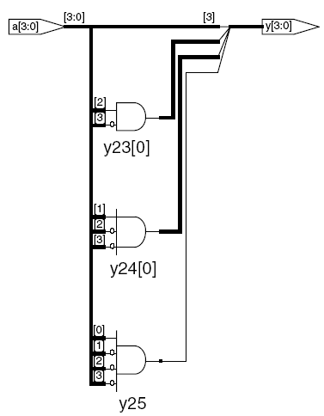
Combinational Logic using casez
module priority_casez(input logic [3:0] a,
output logic [3:0] y);
always_comb
casez(a)
4'b1???: y = 4'b1000; // ?=don’t care
4'b01??: y = 4'b0100;
4'b001?: y = 4'b0010;
4'b0001: y = 4'b0001;
default: y = 4'b0000;
endcase
endmodule

Slide 18
Parameterized Modules
2:1 mux:
module mux2
#(parameter width = 8) // name and default value
(input logic [width-1:0] d0, d1,
input logic s,
output logic [width-1:0] y);
assign y = s ? d1 : d0;
endmodule
Instance with 8-bit bus width (uses default):
mux2 myMux(d0, d1, s, out);
Instance with 12-bit bus width:
mux2 #(12) lowmux(d0, d1, s, out);

Slide 19
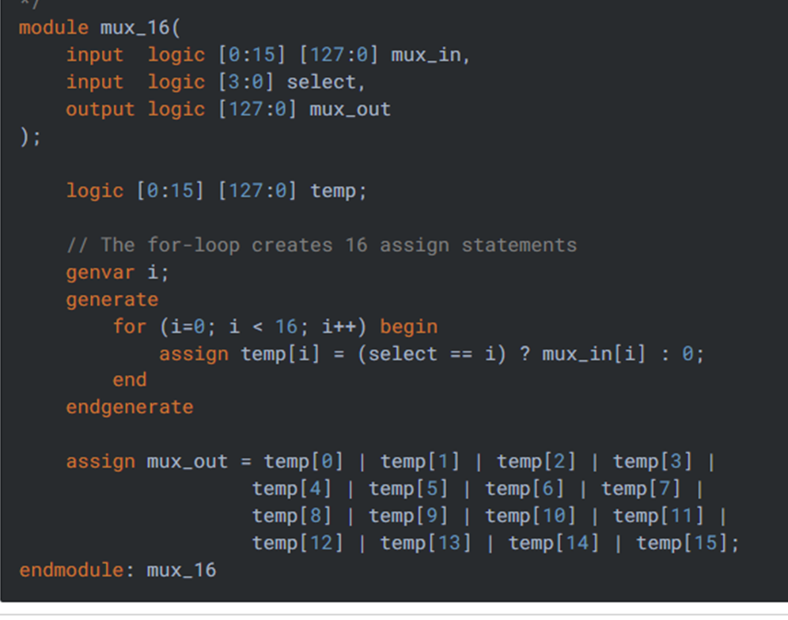
Generate statements
The loop generate construct provides an easy and concise method to create multiple instances of module instances, assign statements and so on. Think of it as a cloning machine.

Slide 20
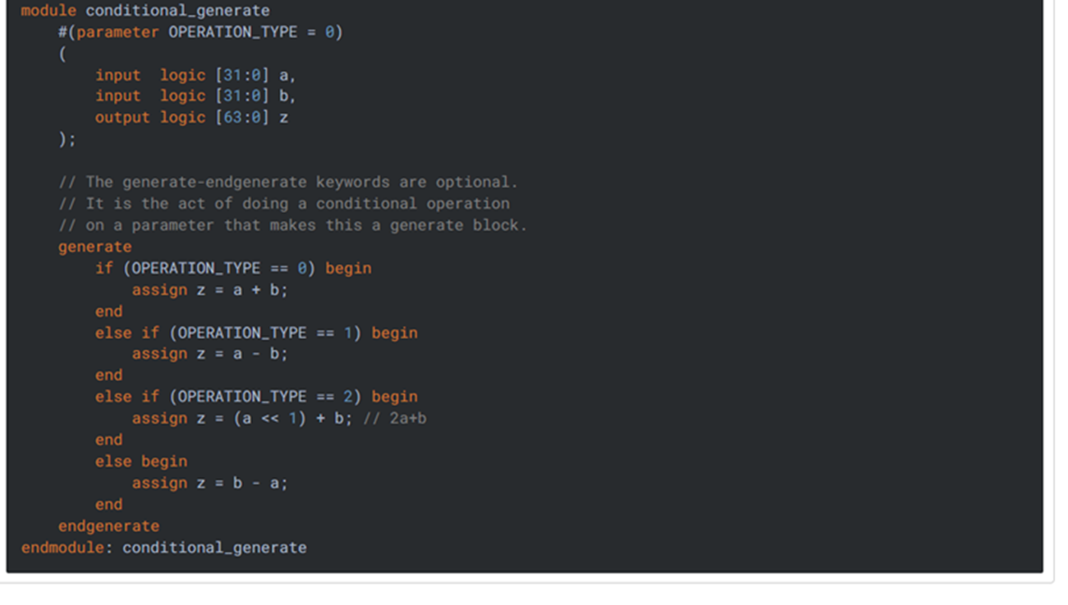
Conditional Generate
Conditional generate construct lets you alter the structure of your design based on Parameter values.

Slide 21
Testbenches
HDL that tests another module: device under test (dut)
Not synthesizeable
Types:
Simple
Self-checking
Self-checking with testvectors

Slide 22
Testbench Example
Write SystemVerilog code to implement the following function in hardware:
y = bc + ab
Name the module sillyfunction

Slide 23
Testbench Example
Write SystemVerilog code to implement the following function in hardware:
y = bc + ab
module sillyfunction(input logic a, b, c,
output logic y);
assign y = ~b & ~c | a & ~b;
endmodule

Slide 24
Simple Testbench
module testbench1();
logic a, b, c;
logic y;
// instantiate device under test
sillyfunction dut(a, b, c, y);
// apply inputs one at a time
initial begin
a = 0; b = 0; c = 0; #10;
c = 1; #10;
b = 1; c = 0; #10;
c = 1; #10;
a = 1; b = 0; c = 0; #10;
c = 1; #10;
b = 1; c = 0; #10;
c = 1; #10;
end
endmodule

Slide 25
Self-checking Testbench
module testbench2();
logic a, b, c;
logic y;
sillyfunction dut(a, b, c, y); // instantiate dut
initial begin // apply inputs, check results one at a time
a = 0; b = 0; c = 0; #10;
if (y !== 1) $display("000 failed.");
c = 1; #10;
if (y !== 0) $display("001 failed.");
b = 1; c = 0; #10;
if (y !== 0) $display("010 failed.");
c = 1; #10;
if (y !== 0) $display("011 failed.");
a = 1; b = 0; c = 0; #10;
if (y !== 1) $display("100 failed.");
c = 1; #10;
if (y !== 1) $display("101 failed.");
b = 1; c = 0; #10;
if (y !== 0) $display("110 failed.");
c = 1; #10;
if (y !== 0) $display("111 failed.");
end
endmodule

Slide 26
Testbench with Testvectors
Testvector file: inputs and expected outputs
Testbench:
Generate clock for assigning inputs, reading outputs
Read testvectors file into array
Assign inputs, expected outputs
Compare outputs with expected outputs and report errors

Slide 27
Testbench with Testvectors
Testbench clock:
assign inputs (on rising edge)
compare outputs with expected outputs (on falling edge).
Testbench clock also used as clock for synchronous sequential circuits

Slide 28
Testvectors File
File: example.tv
contains vectors of abc_yexpected
000_1
001_0
010_0
011_0
100_1
101_1
110_0
111_0

Slide 29
1. Generate Clock
module testbench3();
logic clk, reset;
logic a, b, c, yexpected;
logic y;
logic [31:0] vectornum, errors; // bookkeeping variables
logic [3:0] testvectors[10000:0]; // array of testvectors
// instantiate device under test
sillyfunction dut(a, b, c, y);
// generate clock
always // no sensitivity list, so it always executes
begin
clk = 1; #5; clk = 0; #5;
end

Slide 30
2. Read Testvectors into Array
// at start of test, load vectors and pulse reset
initial
begin
$readmemb("example.tv", testvectors);
vectornum = 0; errors = 0;
reset = 1; #27; reset = 0;
end
// Note: $readmemh reads testvector files written in
// hexadecimal

Slide 31
3. Assign Inputs & Expected Outputs
// apply test vectors on rising edge of clk
always @(posedge clk)
begin
#1; {a, b, c, yexpected} = testvectors[vectornum];
end

Slide 32
4. Compare with Expected Outputs
// check results on falling edge of clk
always @(negedge clk)
if (~reset) begin // skip during reset
if (y !== yexpected) begin
$display("Error: inputs = %b", {a, b, c});
$display(" outputs = %b (%b expected)",y,yexpected);
errors = errors + 1;
end
// Note: to print in hexadecimal, use %h. For example,
// $display(“Error: inputs = %h”, {a, b, c});

Slide 33
4. Compare with Expected Outputs
// increment array index and read next testvector
vectornum = vectornum + 1;
if (testvectors[vectornum] === 4'bx) begin
$display("%d tests completed with %d errors",
vectornum, errors);
$finish;
end
end
endmodule
// === and !== can compare values that are 1, 0, x, or z.

Slide 34
ADDER
module adder #(parameter N = 8)
(input logic [N–1:0] a, b,
input logic cin,
output logic [N–1:0] s,
output logic cout);
assign {cout, s} = a + b + cin;
endmodule

Slide 35
COMPARATORS
module comparator #(parameter N = 8)
(input logic [N–1:0] a, b,
output logic eq, neq, lt, lte, gt, gte);
assign eq = (a == b);
assign neq = (a != b);
assign lt = (a < b);
assign lte = (a <= b);
assign gt = (a > b);
assign gte = (a >= b);
endmodule

Slide 36
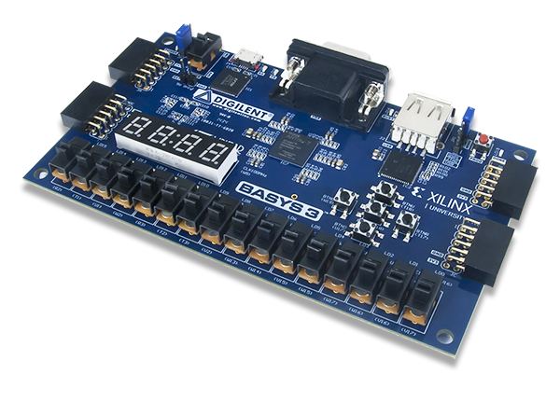
FPGA demo
Git repository:
https://github.com/pontarelli/vpong
FPGA board:
https://digilent.com/reference/programmable-logic/basys-3/start

